Slide 1
SS ZG 526: Distributed Computing
Second Semester 2014-2015
Lect 13: Remaining part of Agreement problem, and deadlock handling
Chittaranjan Hota, PhD
Dept. of Computer Sc. & Information Systems
hota@hyderabad.bits-pilani.ac.in

Slide 2
Agreement Problems: Recap
Problem Who initiates value Final Agreement
Byzantine One Processor Single Value
Agreement
Consensus All Processors Single Value
Interactive All Processors A Vector of Values
Consistency
SS ZG526, Distributed Computing

Slide 3
Oral Message Algorithm
Oral Message algorithm, OM(m) consists of m+1 “phases”
Algorithm OM(0) is the “base case” (no faults)
  Commander sends value to every lieutenant
  Each lieutenant uses value received from commander, or default “retreat” if no value was received
Recursive algorithm OM(m) handles up to m faults
Commander sends value to every lieutenant
For each lieutenant i, let v_{i} be the value i received from commander, or “retreat” if no value was received. Lieutenant i acts as commander and runs Alg OM(m-1) to send v_{i} to each of the n-2 other lieutenants
For each i, and each j not equal to i, let v_{j} be the value Lieutenant i received from Lieutenant j in step (2) (using Alg OM(m-1)), or else “retreat” if no such value was received. Lieutenant i uses the value majority(v₁, … , v_{n-1}) to compute the agreed upon value.
SS ZG526, Distributed Computing

Slide 4
Example OM with m=1, and n=4
y
SS ZG526, Distributed Computing

Slide 5
Continued with Commander being Byzantine
SS ZG526, Distributed Computing

Slide 6
Stages in OM
P1
Stage 0: (n-1) msgs
P2
n-1
Pn
Stage 1: (n-1)(n-2) msgs
P3
n-2
n-2
Pn
Pn-1
P2
.
.
.
.
.
.
.
.
.
P4
Pn
Stage m
.
.
.
SS ZG526, Distributed Computing

Slide 7
O(n^{m}) Complexity of OM
OM(m) triggers n-1 OM(m-1)
OM(m-1) triggers n-2 OM(m-2)
…
OM(m-k) will be called by (n-1)…(n-k) times
…
OM(0)
SS ZG526, Distributed Computing

Slide 8
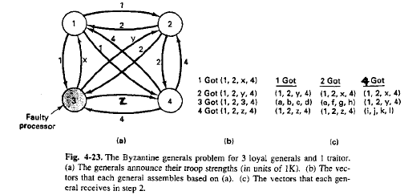
Interactive Consistency Model
SS ZG526, Distributed Computing

Slide 9
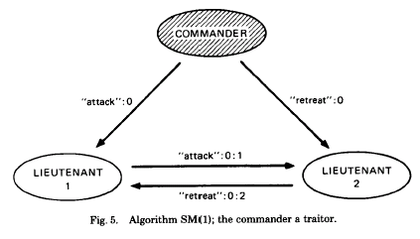
Solution with Signed Messages
We can cope with any number of traitors
Prevent traitors lie about the commander’s order
Messages are signed by commander
The sign can be verified by all loyal lieutenants
All loyals receive the same set of commands eventually
If the commander is loyal, it works
SS ZG526, Distributed Computing

Slide 10
Applications of BA
Building fault tolerant distributed services
  Hardware Clock Synchronization in presence of faulty nodes
  Distributed commit in databases
SS ZG526, Distributed Computing

Slide 11
Deadlocks in Distributed System
One or more processes waiting indefinitely for resources to be released by other waiting processes.
Can occur on h/w or s/w resources, but mostly seen on distributed databases (Lock & Unlock).
T₁
T₂
…
lock(x)
…
lock(y)
…
….
lock(y)
…
lock(x)
time
SS ZG526, Distributed Computing

Slide 12
Ways to handle deadlocks
-Prevention
-Avoidance
-Detection and resolution
-Ignorance
SS ZG526, Distributed Computing

Slide 13
False deadlocks
P0
R
P2
System A
System B
S
P1
T
SS ZG526, Distributed Computing

